Slide 1

PHISHSECURE-A Phishing Website detection using ML
by
O Vinitha chakravarthy
Roll No. 214G1A32C2
D Shabnam
Roll No. 214G1A3298
S Sarfaraaz Ahmed
Roll No. 214G1A3297
P Sai Reddy
Roll No. 214G1A3292
Under the guidance of
Dr.P.Chitralingappa,M.Tech.,Ph.D..
Assistant Professor
Department of Computer Science and Engineering (Data Science)
Srinivasa Ramanujan Institute of Technology
(Affiliated to JNTUA & Approved by AICTE) (Accredited by NAAC with ‘A’ Grade & Accredited by NBA (EEE, ECE & CSE)
Rotarypuram Village, B K Samudram Mandal, Ananthapuramu – 515701.
2024 - 2025

Slide 2

Contents
Abstract
Introduction
Literature survey
Proposed Work
References
GitHub Link
Queries

Slide 3
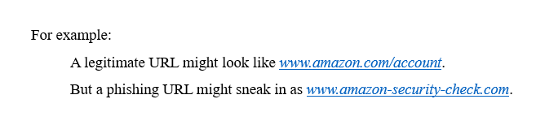
Abstract
Phishing is an internet scam in which an attacker sends out fake messages that look to come from a trusted source. A URL or file will be included in the mail, which when clicked will steal personal information or infect a computer with a virus. Traditionally, phishing attempts were carried out through wide-scale spam campaigns that targeted broad groups of people indiscriminately. The goal was to get as many people to click on a link or open an infected file as possible. There are various approaches to detect this type of attack. One of the approaches is machine learning. The URL’s received by the user will be given input to the machine learning model then the algorithm will process the input and display the output whether it is phishing or legitimate. There are various ML algorithms like SVM, Neural Networks, Random Forest, Decision Tree, XG boost etc. that can be used to classify these URLs. By extracting and comparing different characteristics between legitimate and phishing URLs, the suggested method uses gradient boosting classifier to identify phishing URLs. The studies’ findings demonstrate that the suggested appr successfully identifies legitimate websites from bogus ones in real time.

Slide 4

How phish attack occurs??

Slide 5
Introduction
Phishing as a Cybersecurity Threat: Phishing is a deceptive cyberattack where attackers create fraudulent websites or emails to steal sensitive information like credentials and financial data. It poses significant threats to individuals and organizations globally.
Problem Statement: Despite advancements in detection technologies, phishing attackers continually refine their techniques, making traditional detection methods less effective. A scalable, adaptive solution is needed to accurately detect and prevent phishing attacks in real-time.
Machine Learning as the Solution: Machine Learning (ML) offers an effective solution to this problem by analyzing website features and identifying patterns that distinguish phishing websites from legitimate ones. Unlike traditional rule-based approaches, ML models can dynamically learn and adapt to evolving attack strategies.
Objective of the Research: The goal of this research is to develop an ML-based detection system that analyze and compare different ML algorithms and take the best one to classify URLs as phishing or legitimate by identifying critical features that influence the classification.
Dataset and Methods: Using a dataset of over 11,000 URLs with 30 parameters, Exploratory Data Analysis (EDA) was conducted to extract key features such as "HTTPS", "AnchorURL", and "WebsiteTraffic". Various ML algorithms, including Gradient Boosting and Random Forest, were implemented to evaluate their effectiveness.
Solution and Outcome: Gradient Boosting emerged as the most accurate model, achieving a 97.4% success rate in classification. This model demonstrates the potential to provide a robust and real-time solution to detect phishing websites, reducing the risk of cyberattacks and enhancing online security.

Slide 6
Literature Survey
No | Title | Author | Journal Name & Year | Methodology Adapted | Key Findings | Gaps
1. | Detection of Phishing Websites by Using Machine Learning | M. Korkmaz, O. K. Sahingoz and B. Diri | 11th International Conference on Computing, Communication and Networking Technologies (ICCCNT), and the year is 2022. | they proposed a machine learning-based phishing detection system by using eight different algorithms to analyze the URLs, and three different datasets to compare the results with other works. | The research highlighted the use of HTTPS by phishing websites to evade detection | lexical features of an URL are not taken into consideration which provides optimal results
2 | Detecting Phishing Websites Using Machine Learning | Al swailem, B. Al abdullah, N. Al rumayh, and A. Al sedrani | Journal of Cyber Security and Information Systems, 2023 | Random Forest was implemented as a browser extension to analyze 26 features. | Achieved good accuracy with a well-selected feature set. The system demonstrated the practical application of supervised learning for phishing detection | Low feature range values reduced accuracy and increased execution time.

Slide 7
Literature Survey
No | Title | Author | Author | Journal Name & Year | Methodology Adapted | Key Findings | Gaps
3. | Phishing Detection Using Machine Learning Technique[1]: | J. Rashid, T. Mahmood, M. W. Nisar and T. Nazir | J. Rashid, T. Mahmood, M. W. Nisar and T. Nazir | 11th International Conference on Computing, Communication and Networking Technologies (ICCCNT), 2020 | The system fosters many features in comparison of other software. Its unique features such as capturing blacklisted URL’s. | The proposed system achieved high accuracy rates and outperformed previous works in phishing detection. | Used different approaches rather than machine learning. According to the survey ML is more effective than the other approaches.
4 | Detection of Phishing Websites Using Machine Learning | V. Patil, P. Thakkar, C. Shah, T. Bhat, S. P. Godse | A. Razaque, M. B. H. Frej, D. Sabyrov, A. Shaikhyn, F. Amsaad and A. Oun | 2018 Fourth International Conference on Computing Communication Control and Automation (ICCUBEA) | a database for phishing sites is generated, and the text, links, images, and other data on-site are analyzed for pattern recognition. | The study highlighted the effectiveness of combining multiple detection methods to enhance phishing website identification. | Focused on all the features rather than the important features this makes to increase time complexity.

Slide 8
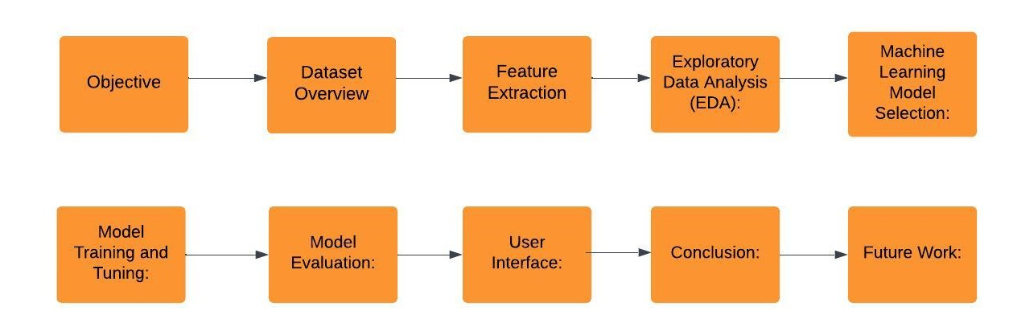
Proposed System

Slide 9
Proposed System
Objective:The goal is to detect phishing websites by analyzing URL features using machine learning, enhancing cybersecurity and preventing data theft.
Dataset Overview : As we aren’t using any list of URLs, this can be used to detect any new URL that the user encounters. We use URL features as parameters to the model. There are 30 features that are being considered as major decision parameters. Using these 30 features an ML model is made to meet the challenges in existing system
Feature Extraction: Key features such as HTTPS, AnchorURL, and WebsiteTraffic are crucial for identifying phishing websites along with factors like Domain age and Redirection.
Exploratory Data Analysis (EDA): EDA reveals important correlations between features and phishing labels, helping to identify which factors most influence website classification.
Machine learning model selection : Various models, including SVM, Neural Networks, and Gradient Boosting, were tested, with Gradient Boosting providing the best performance for phishing detection.
Model Training and Tuning : The dataset was preprocessed, and hyperparameters were tuned to optimize the model’s performance, improving accuracy through cross-validation and grid search.
Model Evaluation : Demonstrating high precision which gives the better accuracy rate comparatively is taken as our final prediction model along with the lexical features combined

Slide 10
Reference
[1].Leon Reznik Computer Security with Artificial Intelligence, Machine Learning, and Data Science Combination,” in Intelligent Security Systems: How Artificial Intelligence, Machine Learning and Data Science Work For and Against Computer Security, IEEE, 2022, pp. 1–56, doi: 10.1002/9781119771579.ch1.
[2]. M. H. Alkawaz, S. J. Steven and A. I. Hajamydeen, "Detecting Phishing Website Using Machine Learning," 2020 16th IEEE International Colloquium on Signal Processing & Its Applications (CSPA), 2020, pp. 111-114.
[3]. V. Patil, P. Thakkar, C. Shah, T. Bhat and S. P. Godse, "Detection and Prevention of Phishing Websites Using Machine Learning Approach," 2018 Fourth International Conference on Computing Communication Control and Automation (ICCUBEA), 2018, pp. 1-5.

Slide 11


Git Hub Dashboards of each student

Slide 12
Any Queries?

Slide 13
Thank You!!!

